Slide 1
The 72nd General Service Conference
April 24th to 30th, 2022
Brooklyn, New York

Slide 2
The Venue: Brooklyn Bridge Marriott
The Medium:
Live (no virtual participation)

Slide 3
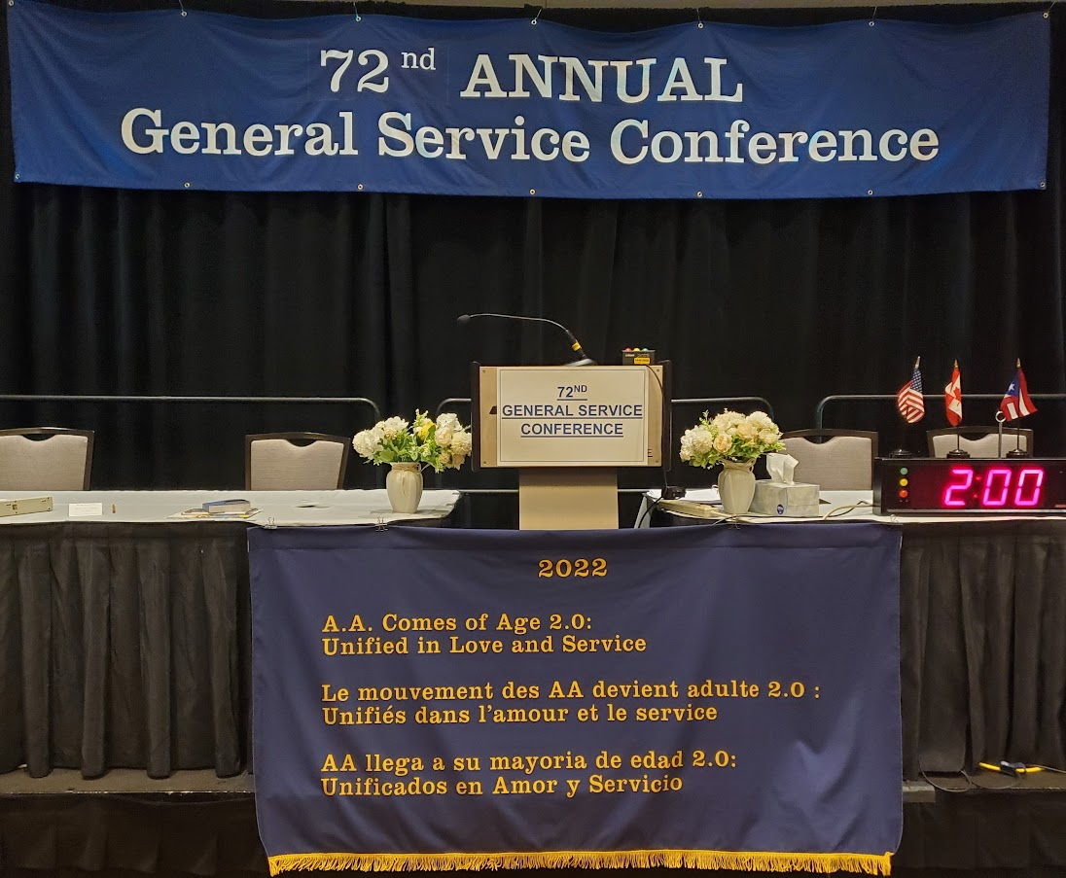

Slide 4
The Delegate’s Questionnaire:
The six Agenda Items on which your groups gave a “yes” or “no”.
(with many thanks to those groups who participated!)

Slide 5
“Consider request that all proposed changes to the book Twelve Steps and Twelve Traditions be handled in footnotes.” Yes o No o
How SENY Voted 223 (85%) 40 (15%)
Did it come to the GSC Floor for discussion and vote?
No – “took no action”
Excerpt from the [Finance] Committee Consideration: “The committee agreed that they did not want to mandate a specific format for possible changes to a future Conference.”

Slide 6
“Consider requests that the chapter titled “The Doctor’s Opinion” be returned to page one, as it was in the First Edition.” Yes o No o
How SENY Voted 156 (58%) 111 (42%)
Did it come to the GSC Floor for discussion and vote? No – “took no action”
Excerpt from the [Report & Charter] Committee Consideration: “The committee added that they did not recognize a strong ‘spiritual need’ to revert to the original pagination.”

Slide 7
“Review request to create a new form of communication to address anonymity on social media.” Yes o No o
How SENY Voted 229 (92%) 19 (8%)
Did it come to the GSC Floor for discussion and vote?
No
Excerpt from the [Public Information] Committee Consideration: “The committee requested the trustees’ Public Information Committee and staff secretary focus on distributing the survey, to all age demographics, particularly a young population, and obtain results that will inform decisions on any future new form of communication.”

Slide 8
“Consider creating a new pamphlet designed to help C.P.C. committees reach as many doctors as possible.” Yes o No o
How SENY Voted 247 (95%) 14 (5%)
Did it come to the GSC Floor for discussion and vote?
No – “took no action”
Excerpt from the [C.P.C.] Committee Consideration: “The committee suggested that service material could be developed for A.A. members on how to speak with their own healthcare provider about Alcoholics Anonymous.”

Slide 9
“Consider a request to include a G.S.R. preamble in the pamphlet “G.S.R.: Your Group’s Link to A.A. as a Whole.” Yes o No o
How SENY Voted 204 (85%) 37 (15%)
Did it come to the GSC Floor for discussion and vote? No – “took no action”
Excerpt from the [Report and Charter] Committee Consideration: “The committee agreed that this statement is better left to local group autonomy.”

Slide 10
“Consider request to revise the pamphlet “The A.A. Group” to reflect the importance of the group as a “spiritual entity” as stated in the Long Form of Tradition Five.” Yes o No o
How SENY Voted 203 (80%) 50 (20%)
Did it come to the GSC Floor for discussion and vote? Yes – by a vote of 117 - 3
Excerpt from the [Treatment and Accessibilities] Committee Recommendation: “The Long Form of Tradition Five be added to the pamphlet “The A.A. Group” on page 12 in the section “What is an A.A. Group?” at its next printing.”

Slide 11
The Delegate’s Questionnaire:
The eight Agenda Items on which your groups gave their thoughts.
(thanks to those groups who took the
time to give me additional information!)

Slide 12
“Review progress regarding development of a Fourth Edition of the book Alcoholicos Anonimos.” Your Group’s thoughts?
Excerpt from the [Literature] Committee Consideration: “The committee requested that a progress report or draft manuscript be brought back to the 2023 Conference Committee on Literature.”

Slide 13
“Review the 2022 Public Information Comprehensive Media Plan.” Your Group’s thoughts?
Excerpt from the [Public Information] Committee Recommendation: “The committee reviewed and accepted the 2022 Public Information Comprehensive Media Plan (CMP). The committee expressed support for the vision and architecture and reported that this version of the CMP brings a practical and implementable plan into vision.”

Slide 14
“Review report on ‘AAGV/La Vina Website, Marketing and Podcast’.” Your Group’s thoughts?
Excerpt from the [Public Information] Committee Consideration: “The committee finds recent modernization of the Grapevine website to be effective and inviting. The committee finds the AA Grapevine Podcast is well received by many A.A. members and an effective method for sharing the collected voices of A.A. members.”

Slide 15
“Review progress report on the development of outward facing pamphlets for the mental health professionals.” Your Group’s thoughts?
Excerpt from the [C. P. C.] Committee Consideration: “The committee noted that utilizing a focus group was a useful approach to explore and identify the needs of mental health professionals when they are addressing the suffering alcoholic.”

Slide 16
“Discuss feasibility research on paid placement of PSA videos on streaming platforms.” Your Group’s thoughts?
Excerpt from the [Public Information] Committee Consideration: “…requested that further research be conducted. The committee offered the following suggestions and looks forward to a report to be brought back to the 2023 Conference Committee on Public Information.”

Slide 17
“Discuss update report on methods of closing the Big Meetings at the International Convention.” Your Group’s thoughts?
Excerpt from the [Int’l Conventions / Regional Forums] Committee Consideration: “The committee understands that a survey has been developed to gather information from the Fellowship regarding aspects of the 2025 International Convention; and that a question(s) regarding use of the Lord’s Prayer and options to the use of the Lord’s Prayer (e.g., the Third Step Prayer, the Seventh Step Prayer and A.A.’s Declaration of Unity) will be added to the survey.”

Slide 18
“Review progress report regarding the translation of the book Alcoholics Anonymous (Fourth Edition) into plain and simple language.” Now that the Fellowship has had some time to consider and discuss this 71st GSC Advisory Action, how does your Group feel about it at this point in time?
Excerpt from the [Literature] Committee Consideration: “The committee requested that a progress report or draft manuscript be brought back to the 2023 Conference Committee on Literature.”

Slide 19
“Discuss the wide-ranging impact the Preamble change has had on our A.A. Fellowship.” Whether your Group is using the A.A. Preamble as approved at the 71st General Service Conference, or whether it’s continued with the former preamble, what has been the Group’s experience in doing so over the past months? Again, keep in mind the wording of the Agenda Item: “Discuss the wide-ranging impact…”
Excerpt from the [Grapevine / La Vina] Committee Consideration: “The committee felt that after careful consideration of Fellowship feedback, it would be premature to quantify the impact when many A.A. members are still either uninformed or ambivalent about the change.”

Slide 20
Floor Actions: 9 of ‘em
The Conference declined to discuss 5 of them;
2 were discussed but not passed;
2 were passed and became Advisory Actions.

Slide 21
By Friday evening, April 29th, the 72nd General Service Conference had approved a total of 35 Advisory Actions, and the General Service Board approved all 35 on April 30th.
The theme for the next (73rd) General Service Conference, scheduled for April 23-29, 2023:
“A.A.’s Three Legacies – Our Common Solution.”

Slide 22
Those were the results of a week of Conference work, as applied to your responses.
(Now let’s take a journey behind the scenes…)

Slide 23
Let’s call it what it was: a super-spreader event
We started the Conference on Sunday morning with 133 voting members.
By Friday evening, more than 10% of our voting members were quarantined in their rooms with Covid-19 – able to watch on-line, but not able to participate.

Slide 24
Masks were optional; by our farewell breakfast on Saturday morning, most people remained unmasked.
Along with voting members, support staff, interpreters and international observers were infected and quarantined.
More than half the Conference Committee Chairs were sick with Covid by the time they were homebound.
One Delegate left early in order to protect their immuno-compromised partner.
Final estimate of those infected: 40 – 50

Slide 25
That’s the last red slide! ☺
Now let’s talk about:
Money (very briefly)
Fellowship, Love and Service
“What I Saw / Heard / Felt”
a Tale of Three Agenda Items
and Some Food for Thought.

Slide 26
Straight from the “Picnic Table”: AUDIT RESULTS
Completed on schedule
Unmodified or “clean” audit opinion (the financial statements are fairly stated in all material respects)
No material weaknesses
No significant deficiencies
Five recommendations (compared to one in 2020 and seven in 2019)

Slide 27
Straight from the “Picnic Table”: 2021 GSO FINANCIAL HIGHLIGHTS
7th Tradition of Self-Support – $10.78 million set another record, up 5.07% from $10.26 million in 2020
Operating Expense - $15.28 million down 31.6% from $22.34 million in 2020
Self-Support - covered 70.5% of operating expense and 142.0% of program service exp m $10.26 million in 2020
AAWS publishing gross profits – $6.30 million down 4.3% from $6.58 million in 2020

Slide 28
The Fellowship of a live General Service Conference (for all you Delegates in Training…)
The joy of meeting others from all over the United States & Canada (and Brazil and Argentina!)
The meals, the hallways, the breaks – always seeking out additional information / new perspectives
People who love A.A. enough to serve it

Slide 29
“What I Saw / Heard / Felt”
Love of our Program / Fellowship
Full Participation on All Levels
Warranty Five at Work / or Not
A Well-Prepared Conference
Opposing Philosophies
Our Incredible Staff

Slide 30
Agenda Items – Tale #1: Online Groups (follow-up)
“It should be reemphasized that the Conference is not a political body, demanding a completely rigid formula of representation. What we shall need will always be enough delegates at the Conference to afford a reliable cross section of A.A. plus enough more to make sure of good local communication.”
– Bill W. memo following the 1961 Conference, regarding a question “on problems regarding geography and A.A. population”.

Slide 31
Agenda Items – Tale #2: Messaging the Fellowship
Floor Action #9:
It was recommended that: “The 1995 Conference Advisory Action be reaffirmed that the first 164 pages of the Big Book, the Forewords, “The Doctor’s Opinion,” “Doctor Bob’s Nightmare” and the Appendices remain as is.”

Slide 32
Agenda Items – Tale #3: Inclusion (Part 1)
“The committee recommended that the compilation of all Conference committee background be made available annually on or before February 15 in English, French and Spanish.”

Slide 33
Agenda Items – Tale #3: Inclusion (Part 2)
“The committee recommended that the compilation of all Conference committee background be made available annually on or before February 15 in English, French and Spanish.”
Became:
Advisory Action #20: “The compilation of all Conference committee background be made available simultaneously in English, French and Spanish.”

Slide 34
Thoughts for your Reflection

Slide 35
My Favorite Quote from the 72nd GSC:
“Blessed are those who have nothing to say, and the courage not to say it.”

Slide 36
I received Delegate’s Questionnaires from 297 groups – group participation was up about 25% from last year.
Thank you for being part of the 15% of all the groups in SENY who let their voices be heard this year – it matters.

Slide 37
What can we – your Delegate and your other Area Officers – do to make your service experience more meaningful and satisfying?
Come and tell us at our Area Inventory in November! Both the outgoing Panel 71s and the incoming Panel 73s will be there to listen to you.
And speaking of our November Assembly…

Slide 38
The NERT (Northeast Regional Trustee)
Our beloved Francis G. is rotating on next April. Who will make themselves available as a candidate from SENY?
The letter from GSO will be available on aaseny.org/From The Delegate shortly; selection for SENY’s candidate will be at our Area Assembly on November 10th.
Will you stand and be available?

Slide 39
Our SENY Elections, Panel 73 Officers: Saturday, September 10th (virtual)
Delegate
Alternate Delegate
Chair
Treasurer
Tech/Comm Officer
Are you available to serve???

Slide 40
[This space left blank for anything I forgot]

Slide 41
Thank you for this opportunity to serve SENY and Alcoholics Anonymous! I am incredibly grateful for this privilege.
Tom B. – Delegate
Area 49, Panel 71
delegate@aaseny.org

